Slide 1

GET STARTED
CONTRIBUTION

Slide 2
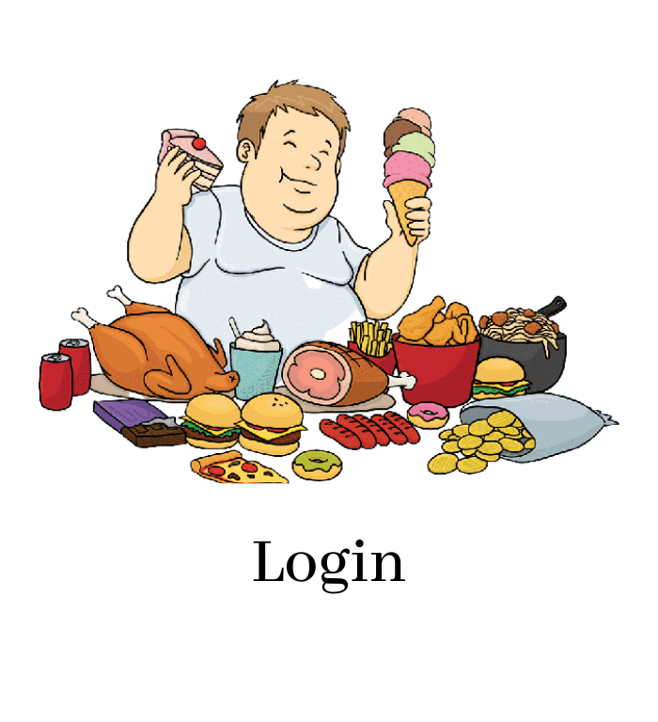
Log In
Hello! Let’s get started
User Log In
Admin Log In
UserName :
Password :
Login
Don’t have an account?
Sign Up

Slide 3
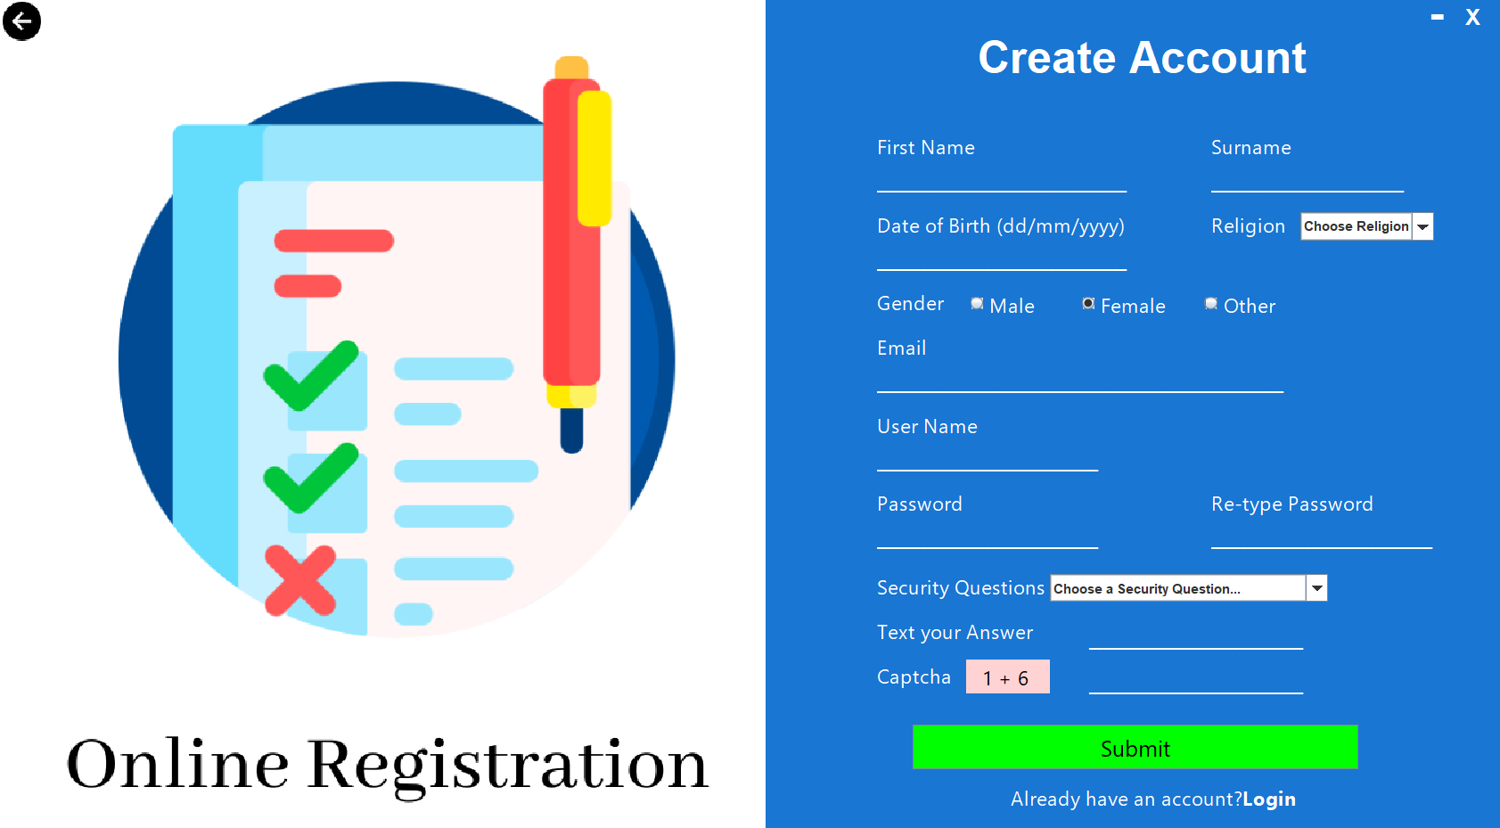

Slide 4
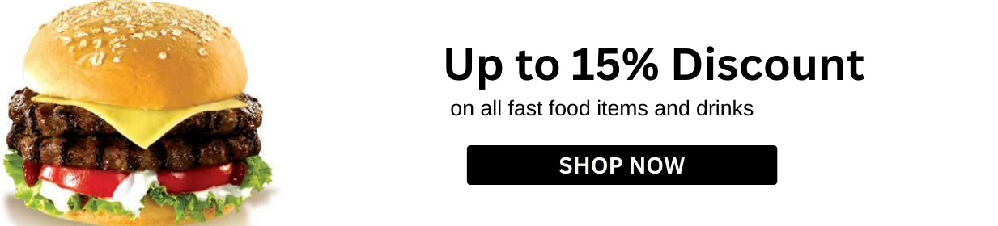

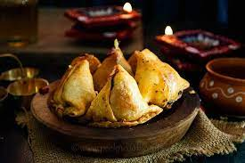
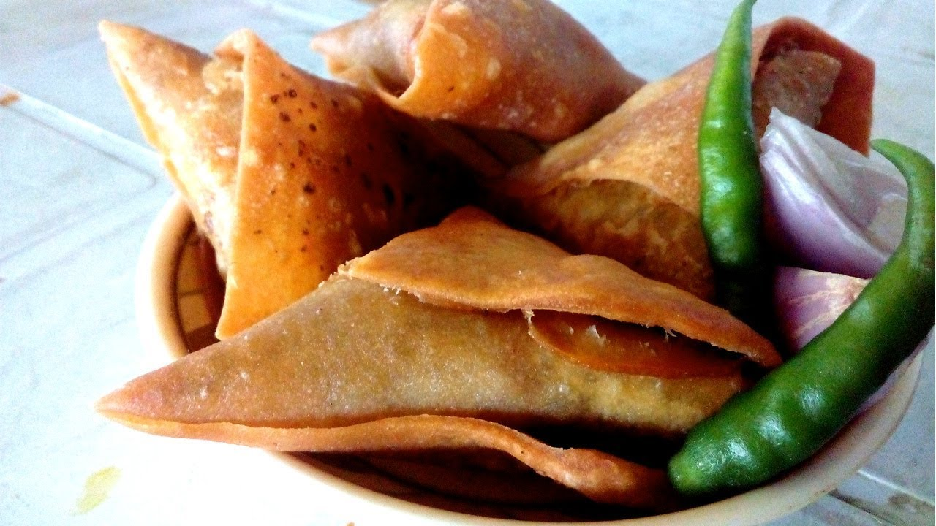
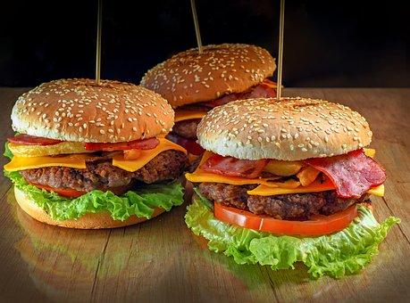
Welcome to our Fast Food Train
Singara
Samocha
Burger

Slide 5
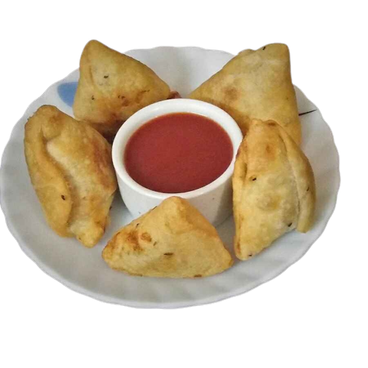
Welcome to our Fast Food Train
Kolija Singara
Alu Singara
BDT 20 tk
BDT 10 tk

Slide 6
Welcome to our Fast Food Train
Kolija Singara
Quantity
BDT 20
Buy Now

Slide 7
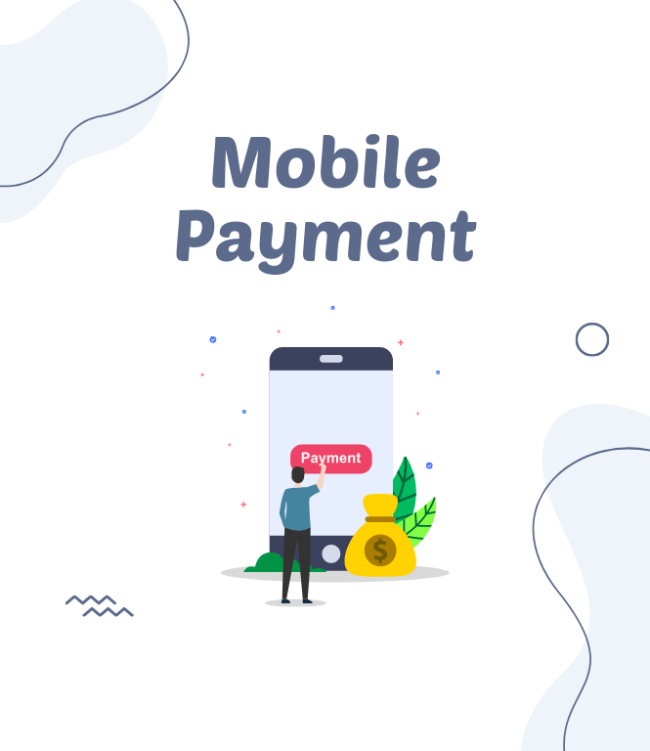

Secure Payment
Admin Log In
Number :
Password:
Pay

Slide 8
Payment Successful
Back on Homepage

